Slide 1
Neuromend
By Tempest
An ICT313 Games Technology Project
Ary Bizar, Anopan Kandiah, Hannah Klinac, Alex Mlodawski, Bryan Yu

Slide 2
Outline
Introduction
Project background and client specification
The solution and what Tempest delivered
Project management
Technologies utilized (hardware + software)
Videos and live demonstrations
Final status
Future possibilities
Lessons learned Acknowledgements
Questions?

Slide 3
Introduction
Client: Shri Rai
Supervisor: Fairuz Shiratuddin
Tempest:
Ary Bizar (Bsc, Games Technology, Games Art and Design)
World designer, Modeller
Anopan Kandiah (Bsc, Computer Science, Games Technology)
Kinect development
Hannah Klinac (Bsc, Computer Science, Games Technology)
Leap Motion development, Project Management
Alex Mlodawski (Bsc, Computer Science, Games Technology)
Kinect development
Bryan Yu (Bsc, Computer Science, Games Technology)
Razer Hydra, Database
Project Name: Neuromend

Slide 4
Background + Client Specification
Stroke
How it affects the brain
Rehabilitation
Rewiring
Rehabilitation
ACCESSIBILITY
TIME/MONEY
Expensive
Tedious/boring – no incremental goals
Limited
Initially evaluation of devices, determined that the project was useful enough to be used in a practical setting (scope creep)
HELPING PEOPLE
Evaluation step towards a more concrete implementation

Slide 5
The Solution
Virtual Simulation
3 different treatments
Tools to assist people
Devices (different accessibility)
Oculus + Keyboard and mouse
Oculus + Razer Hydra
Oculus + Kinect
Oculus + Leap Motion
Sensitivity/Settings
Monitoring progress – can be assessed
Profiles on a database

Slide 6
Project Management
Methodology
SCRUM
Weekly team/supervisor meetings
Source code control
How the project was managed/how the team was managed
How we broke down the work
How we assigned the work

Slide 7
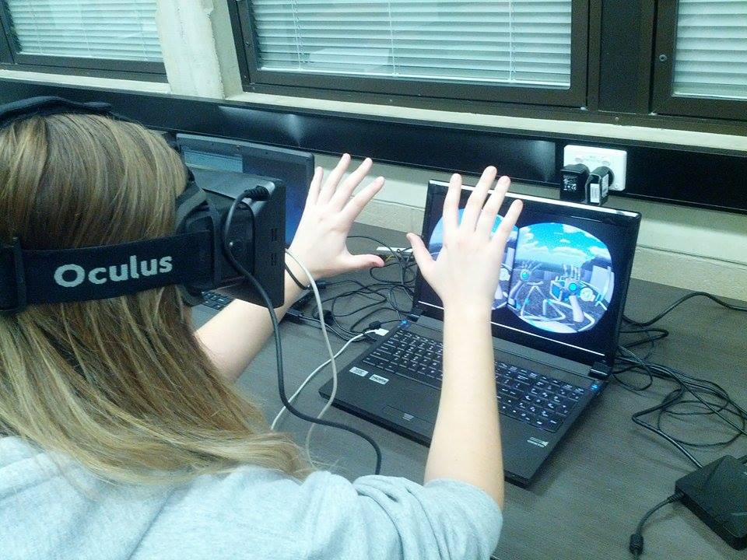
Technologies Utilized
Engine (unity c#)
Hardware()
APIs
3d modelling (3ds)
Data and prfiles (mysql, cleardb)
Software
Unity
C#
API
SDK
3DS Max
Database
Hardware
Oculus Rift
Razer Hydra
Kinect
Leap Motion

Slide 8
Video and Live Demonstrations

Slide 9
Final Status
Virtual Simulation
3 levels
Devices
Database
Sensitivity/settings

Slide 10
Future Possibilities
Clinical use
Shri
Additional control schemes
Speech
EEG
Monitoring variables (stress -> self improve software)

Slide 11
Lessons Learned
Devices
Beta products
Driver clashes
Versions/compatibility
Designing movements/gestures
Version control (levels + devices)
Communication
(beyond IT; teamwork communication, time management, scope creep (requirements))

Slide 12
Acknowledgements
Client – Mr Shri Rai
Supervisor – Dr Fairuz Shiratuddin
AJ - music

Slide 13
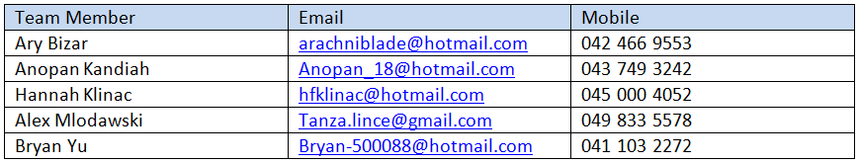
Questions? Make email larger

